Slide 1
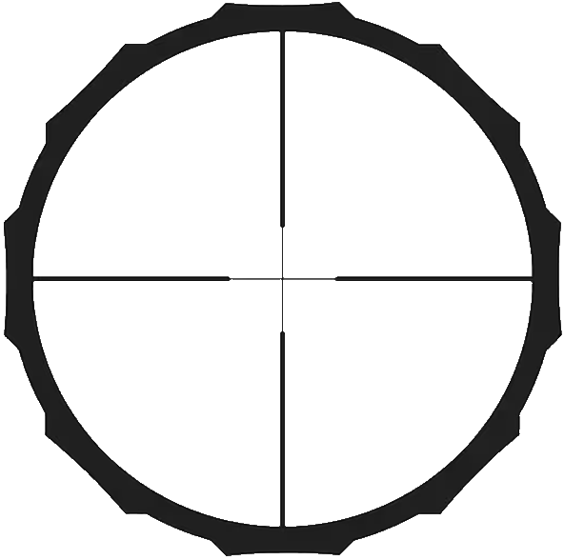
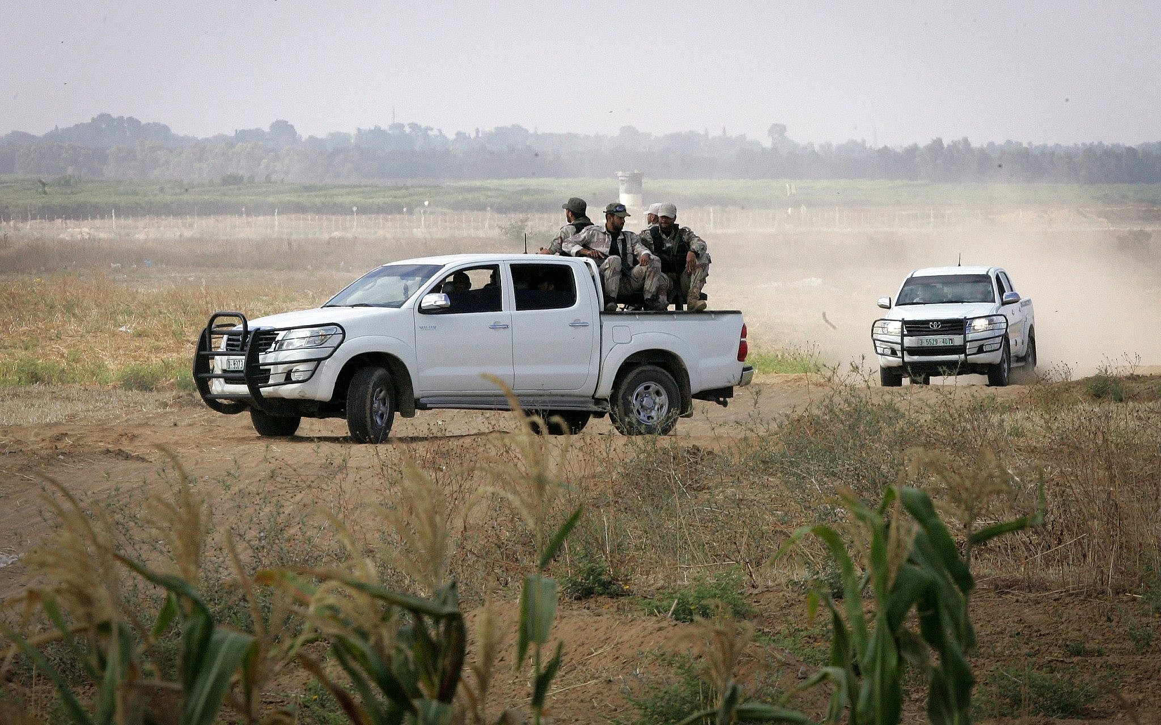
Developing a Detection & Tracking System with C4dynamics
Detection Model: YOLO
Tracking: Kalman Filter
Data Association: sklearn KNeighbors
Framework: C4dynamics

Slide 2

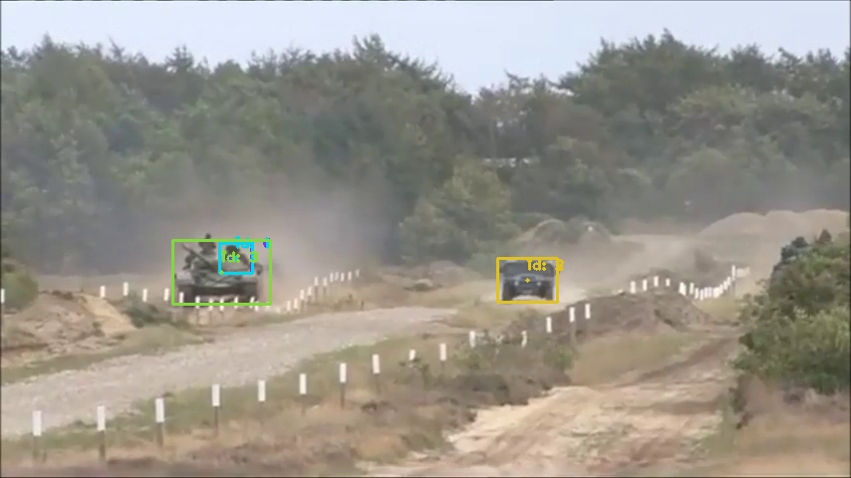
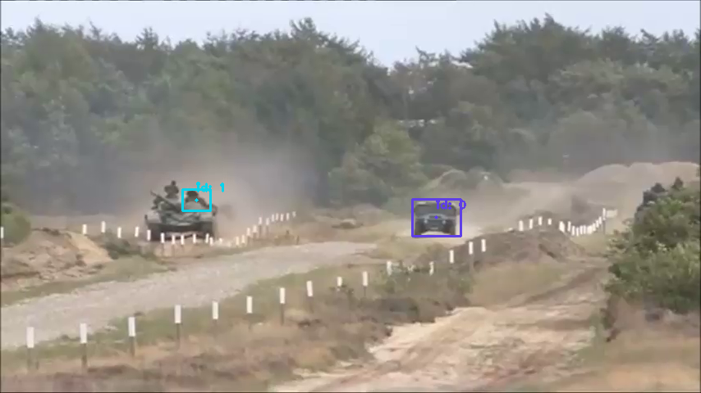
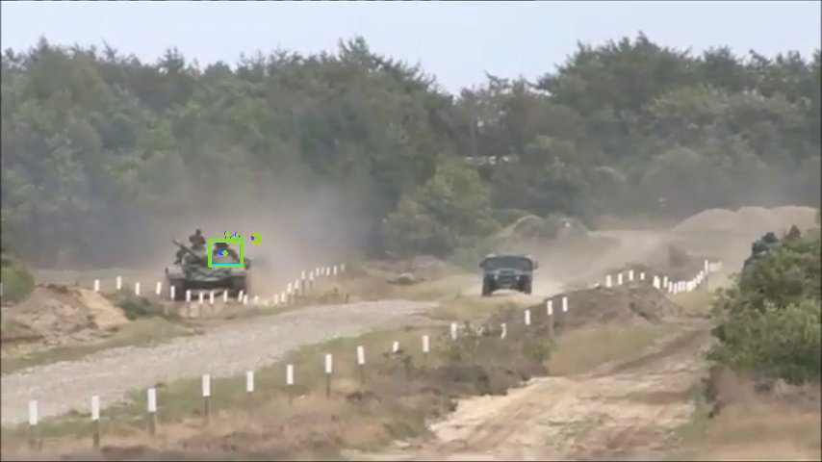
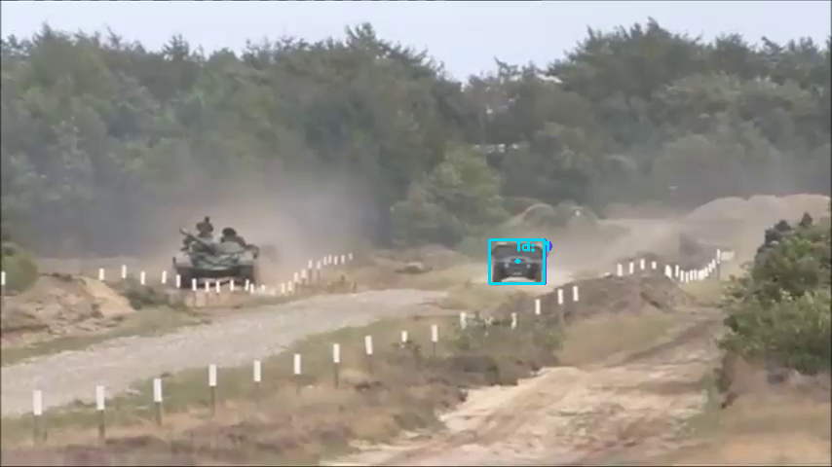
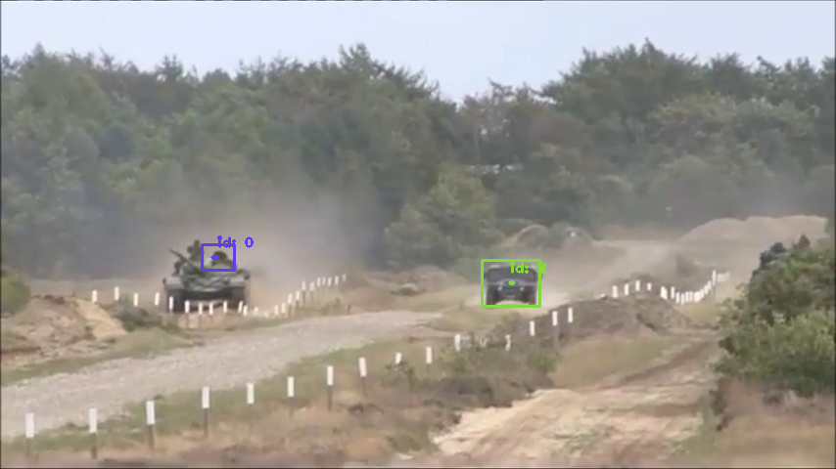
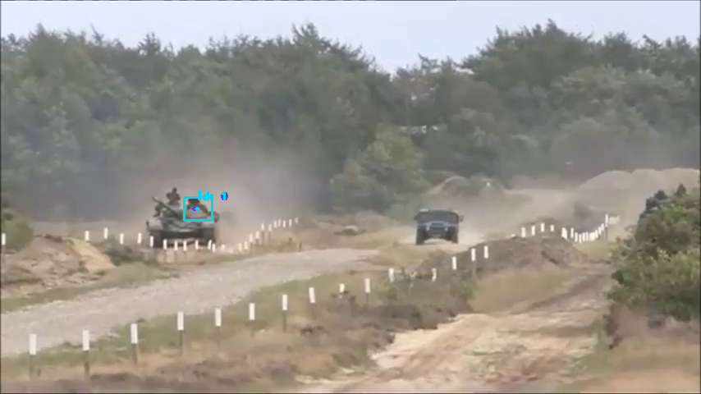
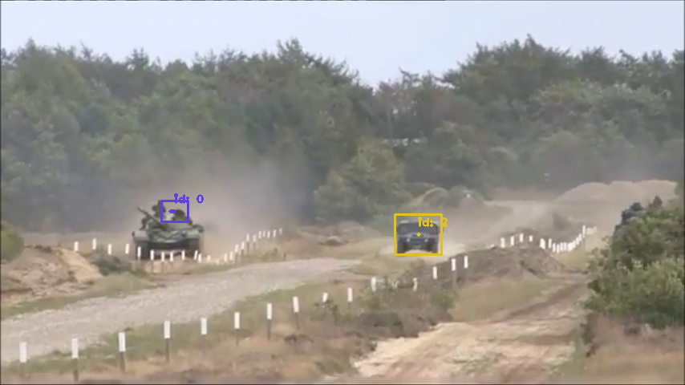
00:00:00.00
00:00:00.27
00:00:00.03
00:00:00.30
00:00:00.10
00:00:00.36
00:00:00.16
00:00:00.40

Slide 3
A system of detection and tracking involves:
Object detection
Classification
Data association
Position measure
Future position prediction

Slide 4

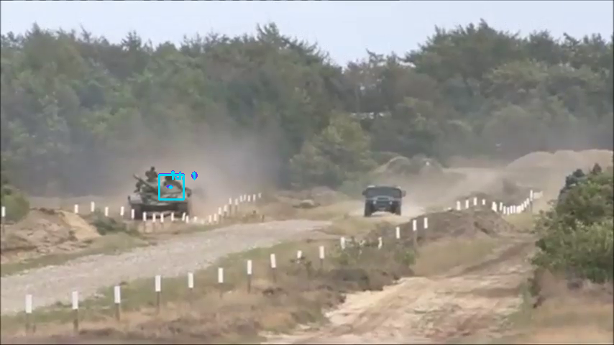
Color == Track ID
Correct operation
Missing track (false negative)
4 different tracks over time
00:00:00.03
00:00:00.23
00:00:00.36
→ The result of environments with high objects density and rapid changes

Slide 5
The 2 figures to be presented here were produced using the following components of C4dynamics (+examples):
An integrated YOLO detector:
det = c4d.detectors.yolo_opencv()
A datapoint as a data-structure for tracks:
track = c4d.datapoint(x = 0, y = 0)

Slide 6
A built-in Kalman filter to each track:
track.kf = c4d.filters.kalman(measure, ..)
Post-process analysis tools.

Slide 7
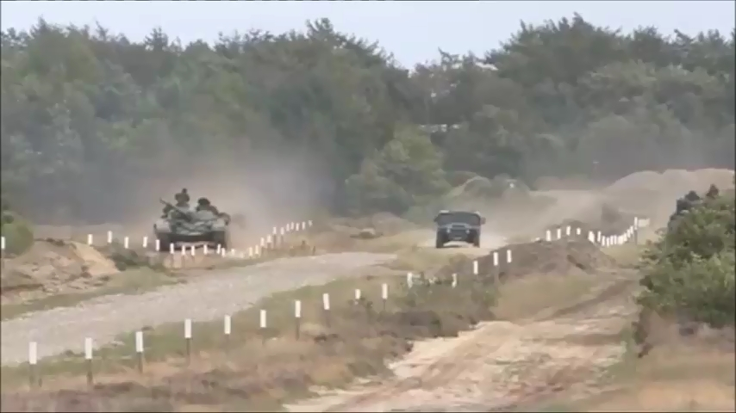
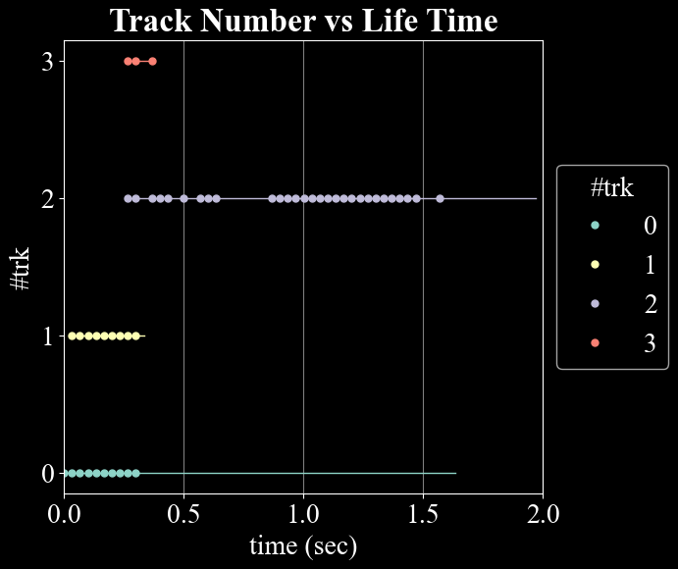
RESULTS 1
2 objects
4 different track-ID’s (over time)
2 objects
4 different track-ID’s (over time)

Slide 8
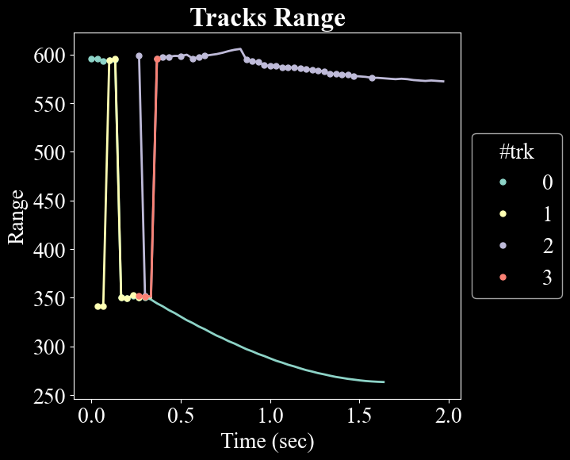
(Positions Figure)
RESULTS 2
Correct separation after the stabilization time.
However, track 0 (green) lacks detections (dots on the line).
-> continues solely with Kalman predictions (linear model).
stabilization time

Slide 9
With just two straightforward visualizations, C4dynamics unveils critical insights that might be challenging to discern, particularly in dynamic, densely populated environments.

Slide 10
Although out of scope, here are some points to consider regarding the discussed anomalies:
Phenomenon | Solution
Missing Detections | Verify the object detected by the model and adjust the CONFIDENCE_THRESHOLD if needed. Find an optimal criterion to update tracks by adjusting the Kalman’s Mahalanobis.
Wrong Detections | Implement post-processing techniques such as Non-Maximum Suppression (NMS) or adjust them. Verify the detection wasn’t associated with the wrong track by training the Nearest-Neighbors model on the relevant tracks only.

Slide 11
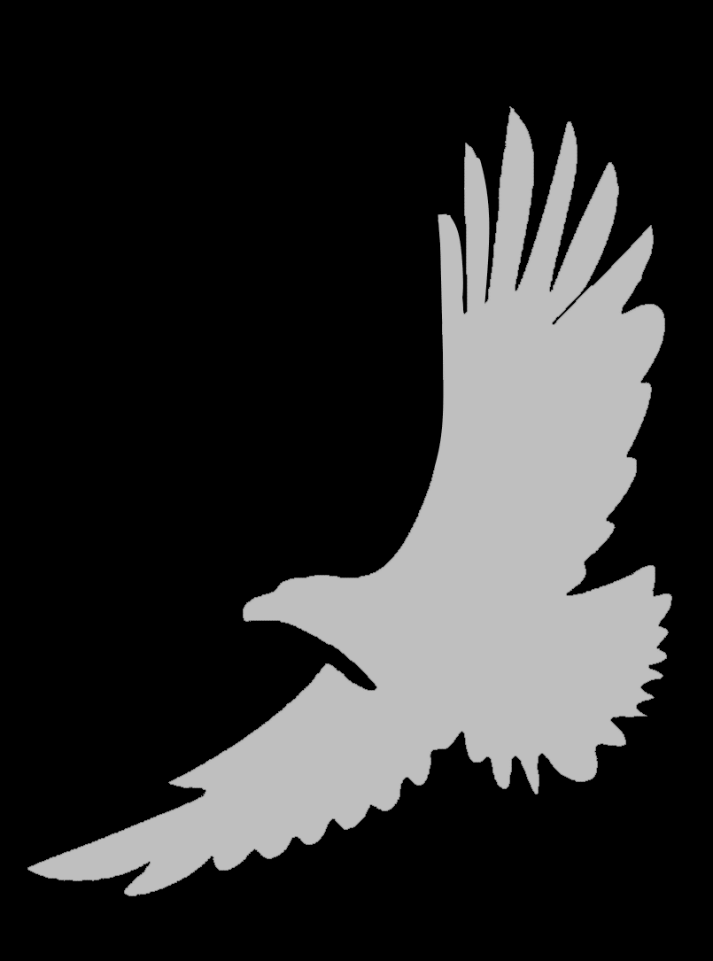
detection and tracking system with C4dynamics
C4dynamics is a framework for the development of any system with dynamics.
See complete example at \example\detect_track.ipynb
Download C4dynamics and start using its component within your project to simplify your analysis and improve performances
Support our GitHub: github.com/C4dynamics

